Slide 1


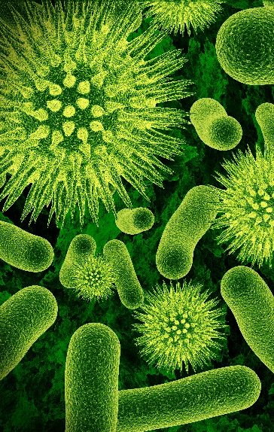






Wrangling Data and Tools in the Wild West
Bonnie Hurwitz, PhD

Slide 2

Challenge: FAIR Tools
Finally
A tool
I can
Run

Slide 3

“I am too old to learn Unix”
Unix & Shell Scripting
Perl /Python programming
R
Distributed computing (HPC)
System administration
Containers (Docker or Singularity)
Bioinformatics packages
Data management best practices
Documentation and reproducibility
Big data analytics (Hadoop)
Software development
Github
Database management
Hardware optimization…
Notes:
A container not bound to higher level constructs such as a particular client or orchestration stack, and
A container not tightly associated with any particular commercial vendor or project, and
A container portable across a wide variety of operating systems, hardware, CPU architectures, public clouds, etc
Composable. All tools for downloading, installing, and running containers should be well integrated, but independent and composable. Container formats and runtime should not be bound to clients, to higher level frameworks, etc.
Portable: The runtime standard should be usable across different hardware, operating systems, and cloud environments.
Secure. Isolation should be pluggable, and the cryptographic primitives for strong trust, image auditing and application identity should be solid.
Decentralized. Discovery of container images should be simple and facilitate a federated namespace and distributed retrieval.
Open. The format and runtime should be well-specified and developed by a community. We want independent implementations of tools to be able to run the same container consistently.
Code leads spec, rather than vice-versa. We seek rough consensus and running code.
Minimalist: The spec should aim to do a few things well, be minimal and stable, and enable innovation and experimentation above and around it.
Backward compatible: Given the broad adoption of the current Docker container format (8B+ container downloads to date), the new standard should strive be as backward compatible as possible with that format.

Slide 4

“Pick two”
Cheap
Fast
Correct
Notes:
A few caveats.
This approach works for bacteria, but not fungi that use other gene markers like 18S or ITS. Profiling viruses using a single gene is not possible given high rates of mutation
This approach will amplify dead bacteria too.
And because this is based on a single gene, we cannot use this approach to assess antibiotic resistance or pathogenecity.
Finally there can also be biases from PCR in the amplification leading to an over representation of certain species. Though it is still fairly accurate.

Slide 5
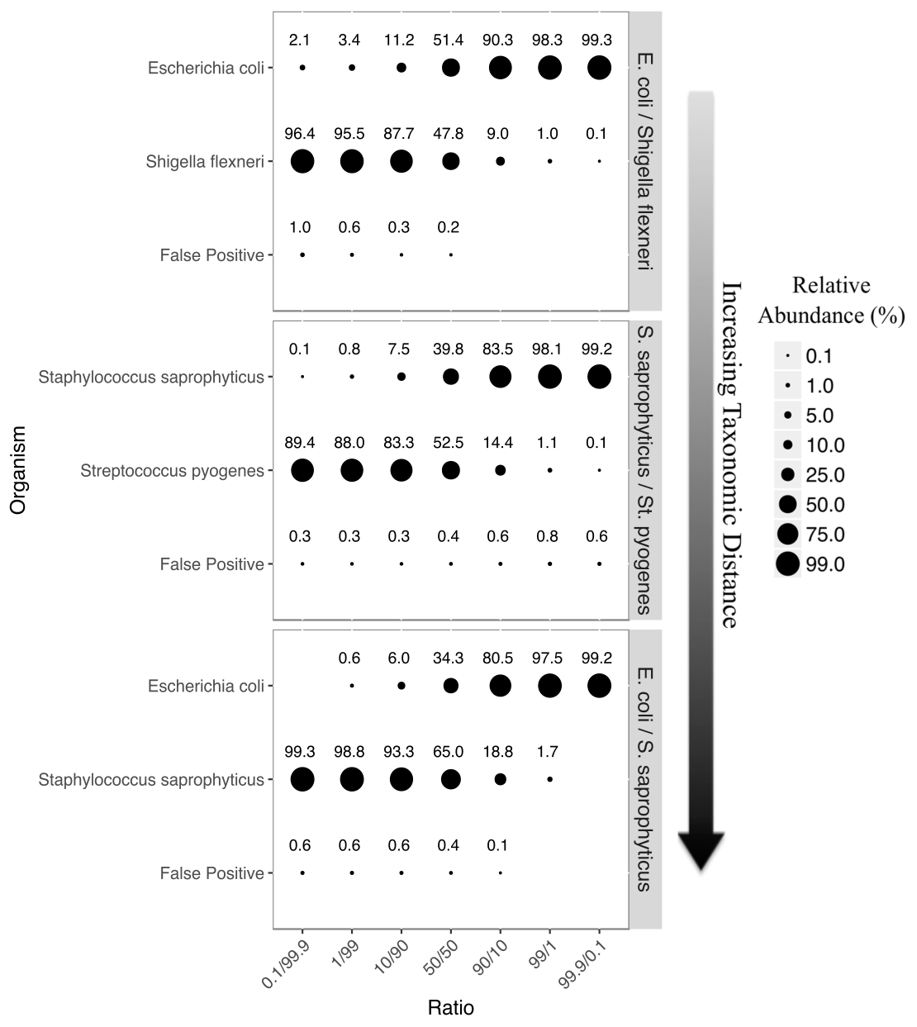
Controlled binary bacterial mixtures
Accuracy
Accuracy using centrifuge
Sample | R²
E. coli / S. flexneri | 0.89
S. saprophyticus / s. pyogenes | 0.99
E. Coli / S. saprophyticus | 0.96

Slide 6
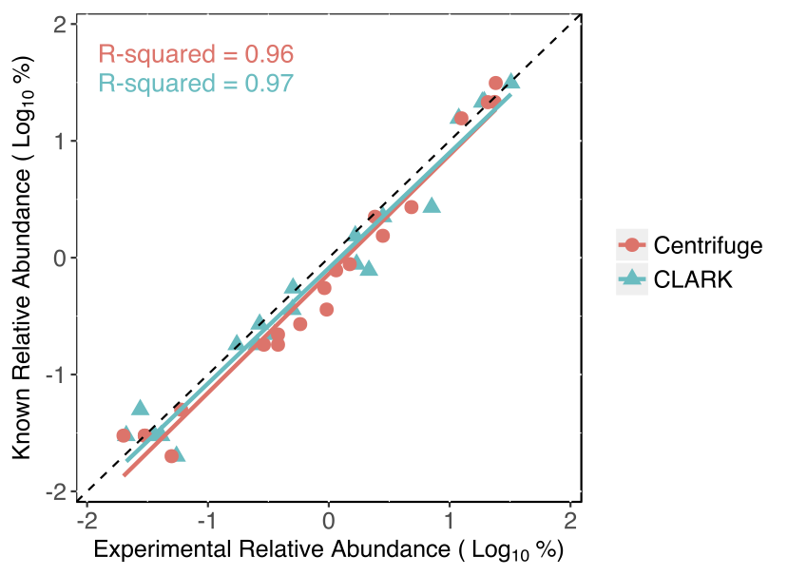
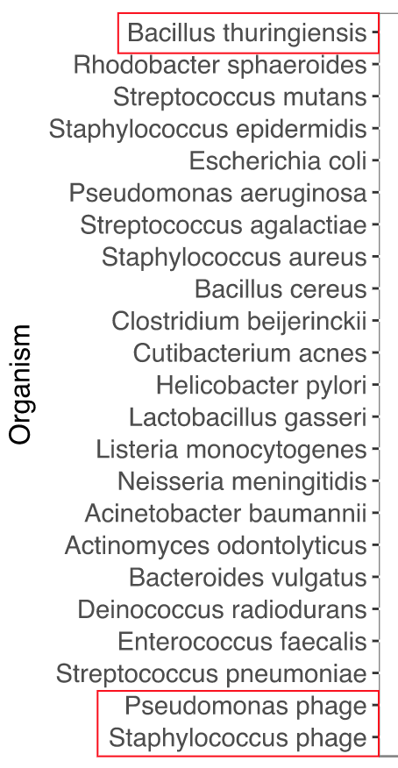
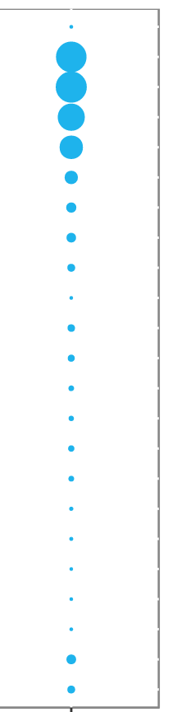
Sensitivity
Staggered Mock Community
Notes:
Bacterial Mock Community Found in Staggered Abundance.
Comparative analysis of two open source taxonomic classification software.
Both methods capable of determining accurate relative abundance.

Slide 7
Speed & Computational Resources
Method | Memory Required | Walltime | R²
Centrifuge | 12 CPUs / 23gb RAM | 0:07:40 | 0.96
CLARK | 28 CPUs / 297gb RAM | 0:38:40 | 0.97
Walltimes for QCed 4.0 gb mock community fasta file

Slide 8
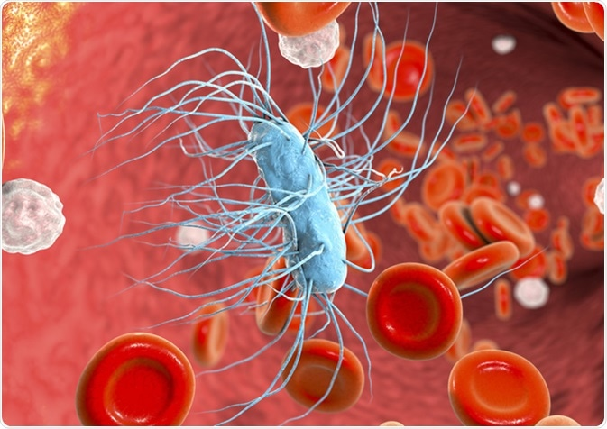





Febrile Neutropenia
Cancer chemotherapy << neutrophil counts
Low culture positive rates (~20%)
WGS can improve diagnostic efficiency

Slide 9

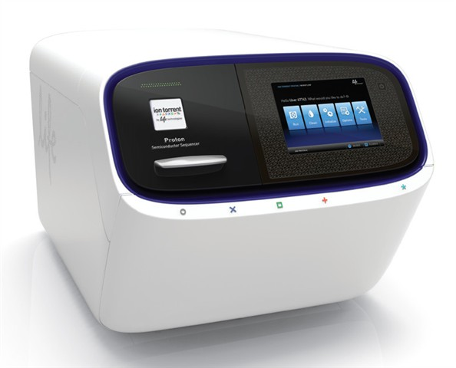
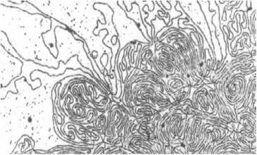
Sample Collection
DNA Isolation
WGS
Sequencing
Notes:
Whole Genome Sequencing (WGS) of the blood belonging to febrile neutropenia patients seeking treatment at University of Arizona Banner Medical Center.

Slide 10
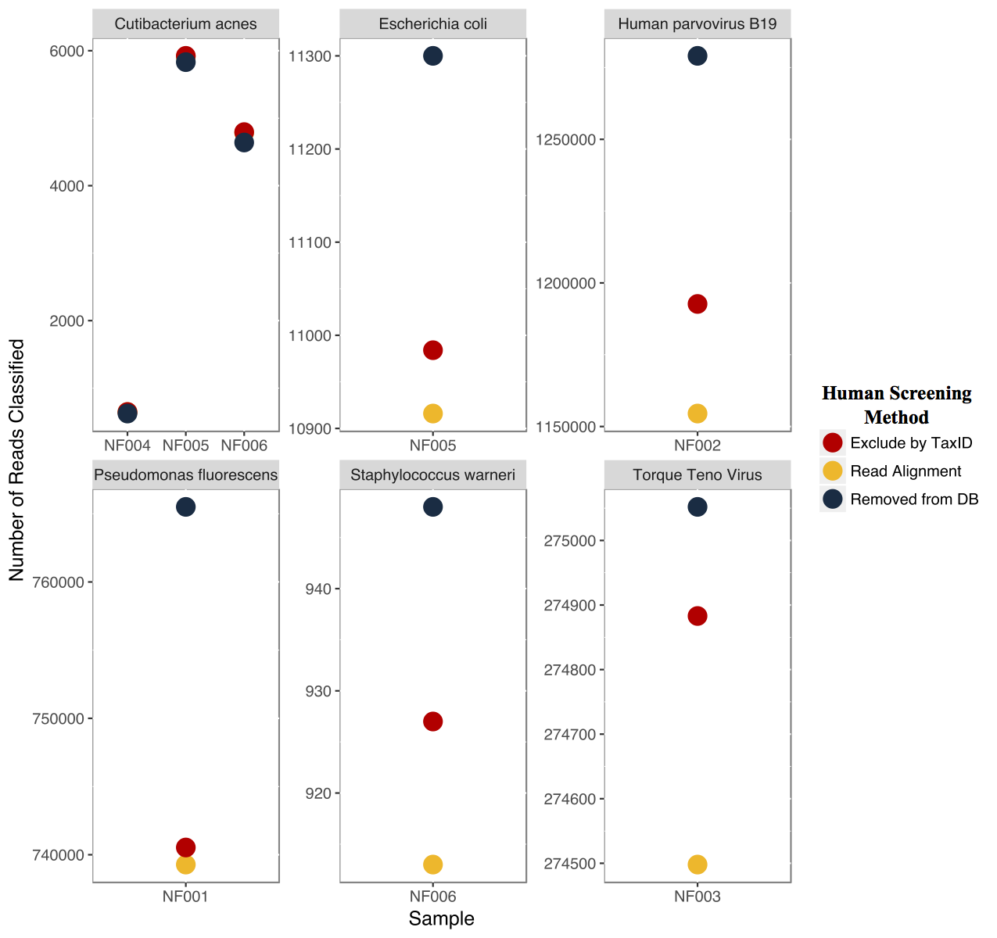
Host Screen Reduces Microbial Hits
Read
recruitment
to the human
genome is
the worst
# Reads Classified
P4
P5
P6
P5
P2
P1
P6
P3
Notes:
Reads classified comparison between host screen methods:
Removed from Database: “Human genome excluded from reference”
Exclude by TaxID:
Centrifuge parameter to ignore human classifications
Read Alignment:
Removal of reads matching human genome using Bowtie2

Slide 11
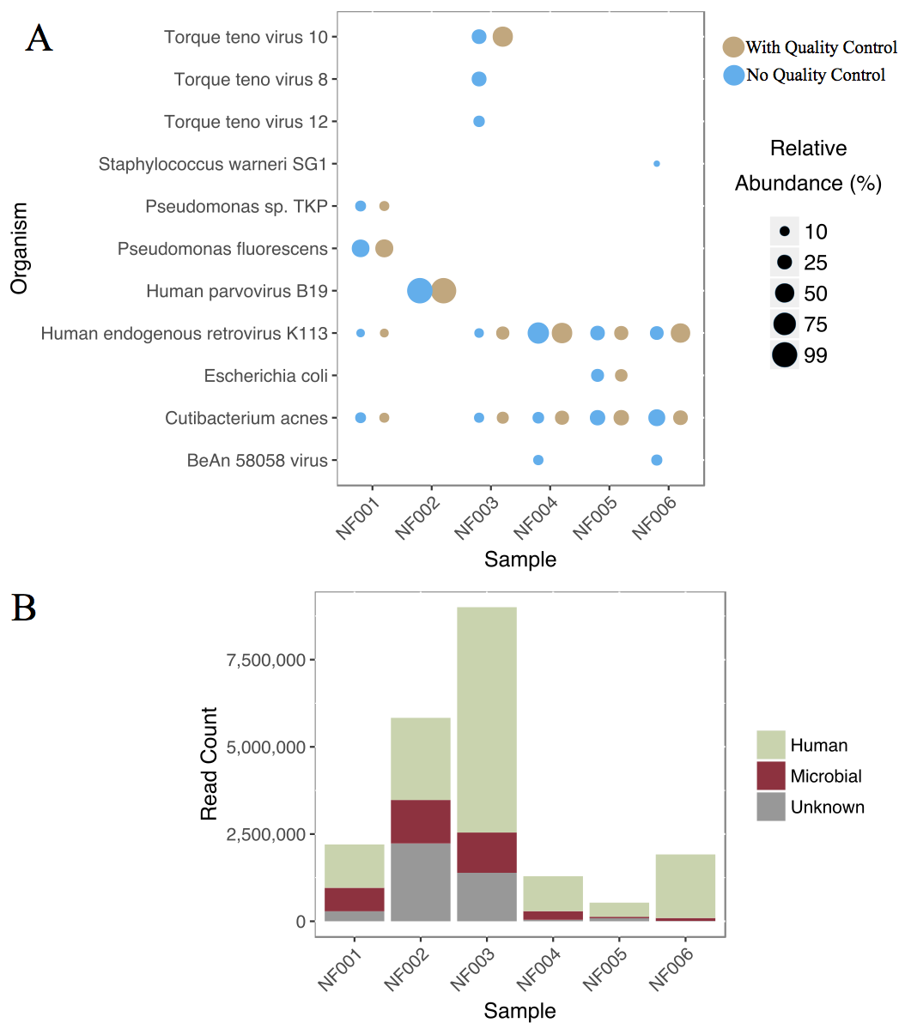
Patients with infection have < contaminants, > reads
Organism
Classification | Net read reduction (%) | Mean read reduction
Bacteria | 6.71 | 8,252
Virus | 47.97 | 115,327 ª
P1
P2
P3
P4
P5
P6
Notes:
High total read counts
(3.5 – 19 million raw reads)
Lower alignment rates to human genome
(41% - 79% of reads)
Higher amount of reads with unknown classification

Slide 12
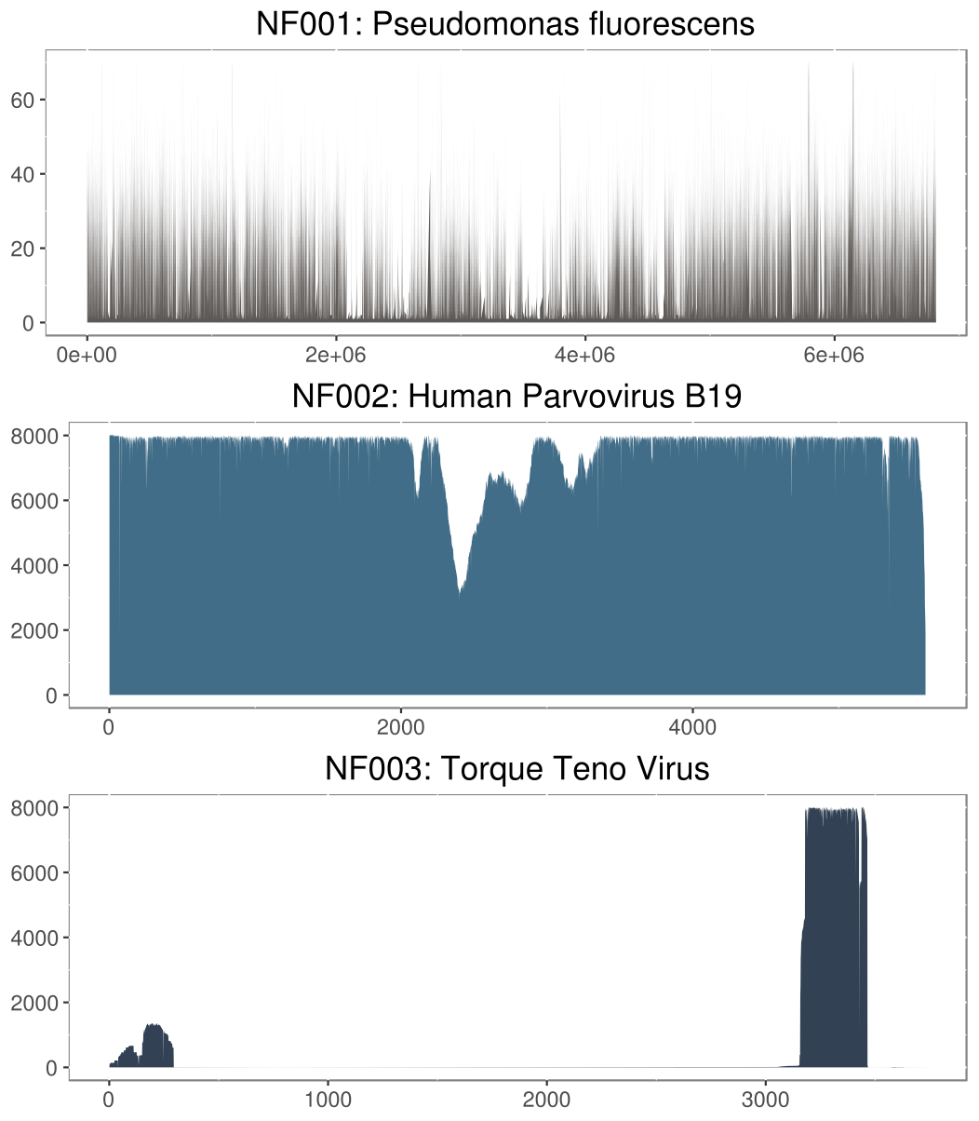
Suspect Organism Genome Coverage
P1: Pseudomonas fluorescens
P1: Pseudomonas fluorescens
Complete
Coverage
P2: Human Parvovirus B19
P3: Torque Teno Virus
Origin of
replication only
Notes:
Suspect Organism Genome Coverage Graphs
Coverage extending the length of the genome would indicate positive identification
Torque teno virus: replication-competent survival

Slide 13
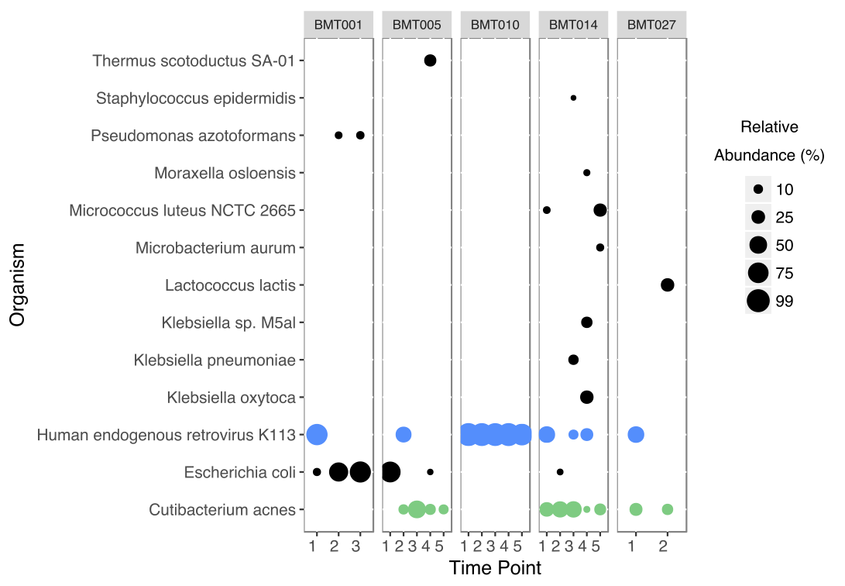
P1
P2
P3
P4
P5
Organism
Suspected
Pathogen

Slide 14
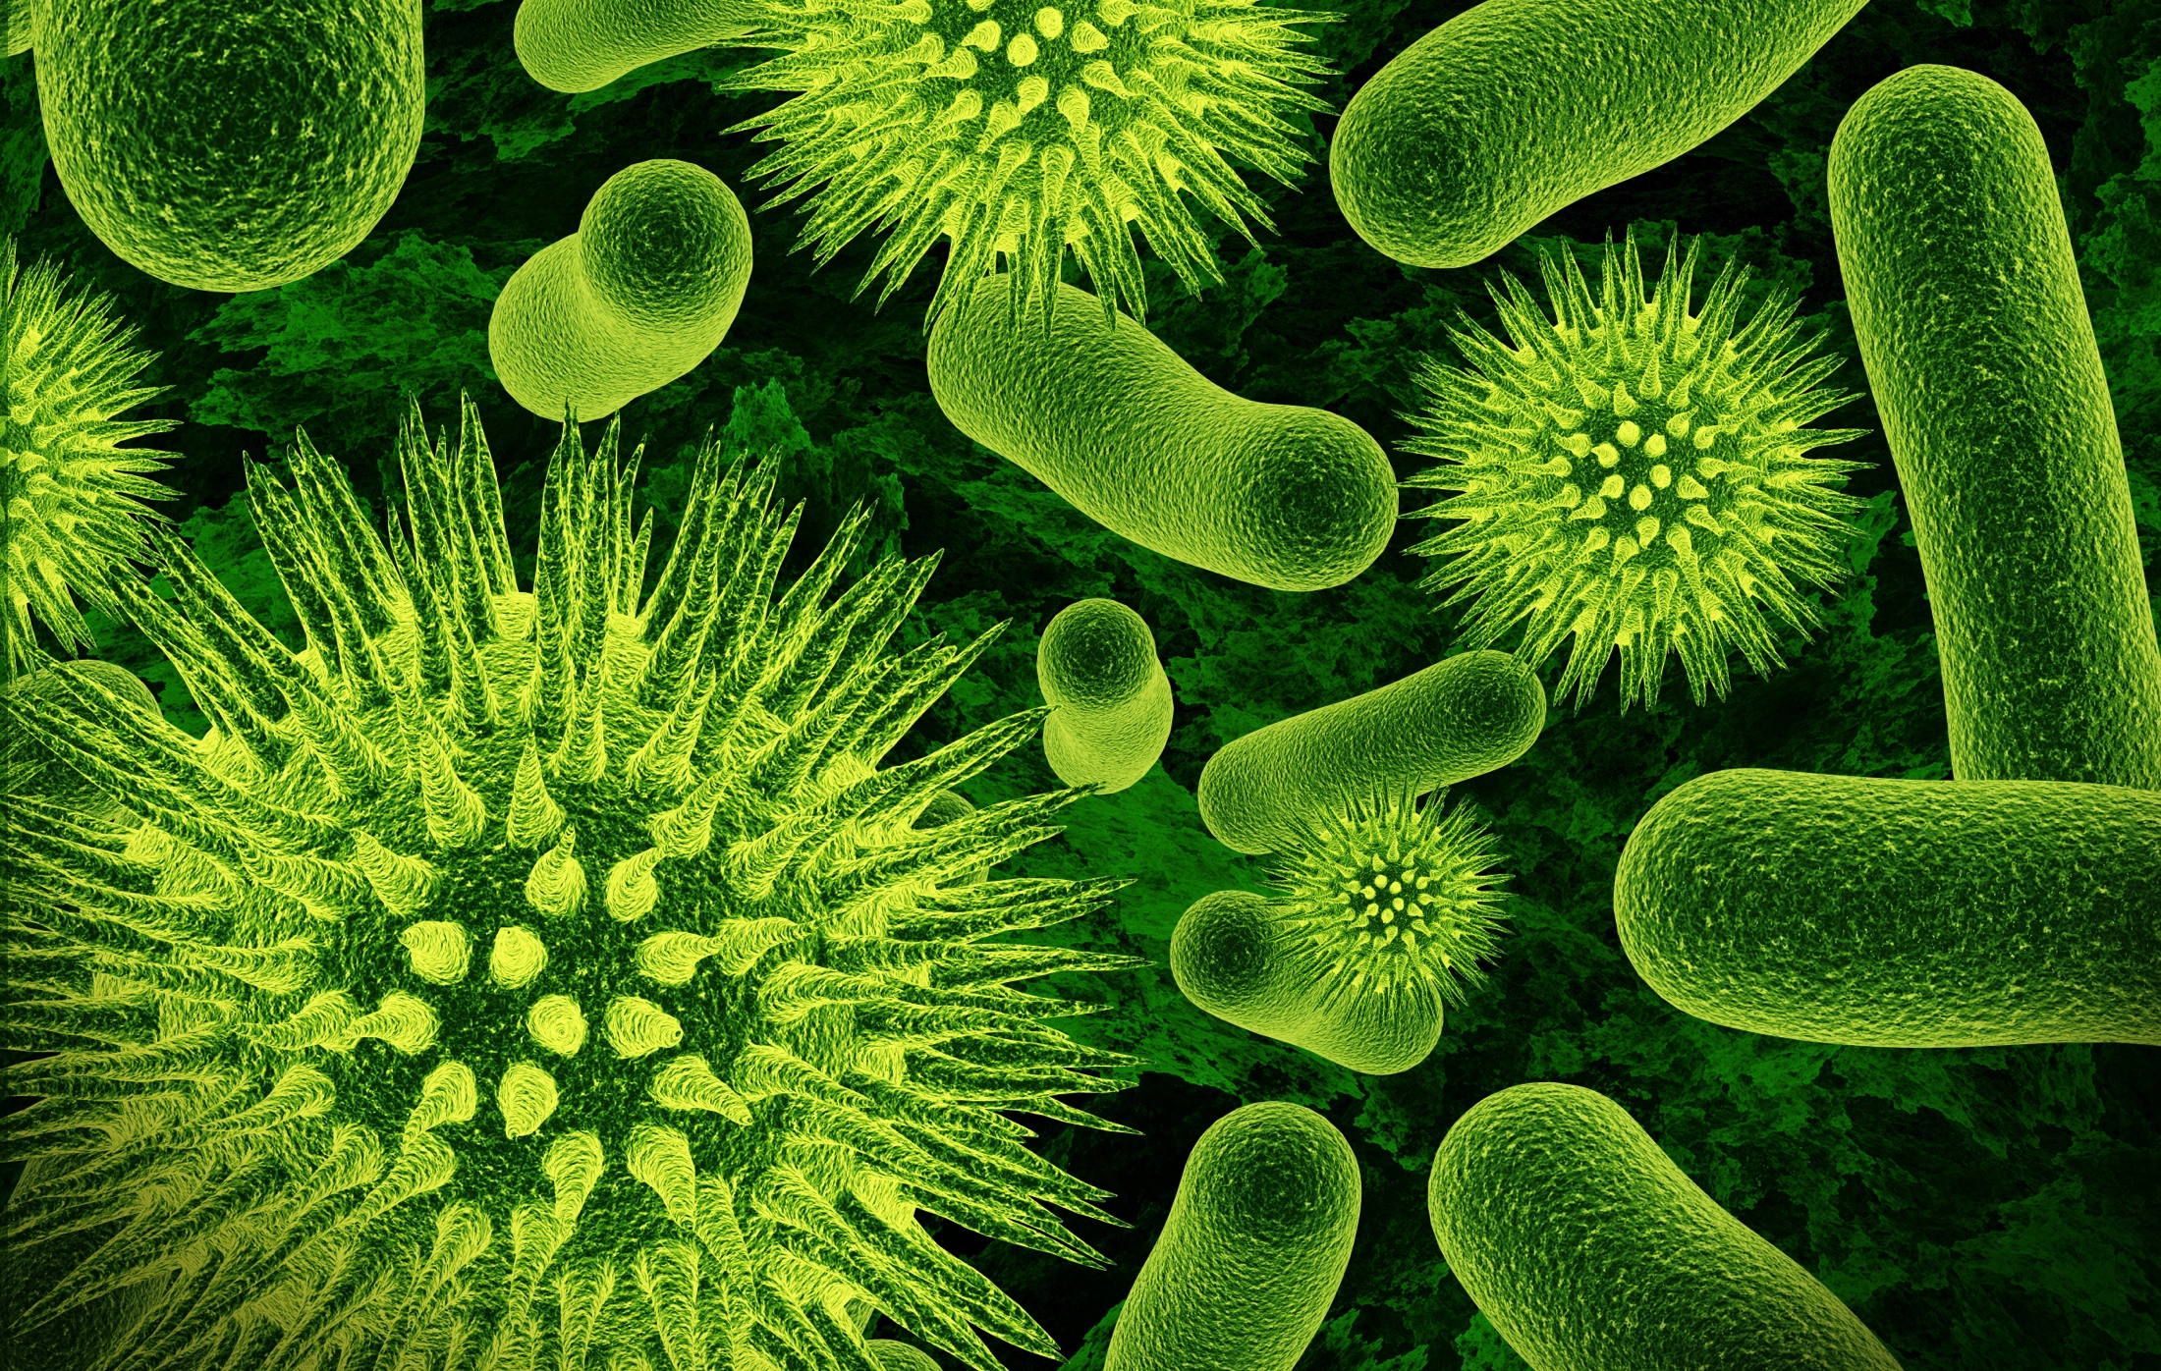
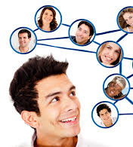

Cyberinfrastructure for Microbial Ecology
Integration
Data Integration & Analysis
Data Storage & Compute
Know-how
Integration
Notes:
The skin microbiome in wound healing can be even more complex,
For example, bacteria like S. aureus can either be pathogenic and cause infection or can colonize a chronic wound and be otherwise benign.
Differentiating between wounds that require antibiotics and those that don’t is fundamental in the ongoing problem of antibiotic resistance
Traditionally, we think of factors that affect wound healing such as bacterial load, diversity and pathogenicity.
But the debate is still out, does bacterial bioburden cause critical colonization,
Or are there interactions among bacteria in biofilm formation that lead to chronic or infected wounds?
The bacterial landscape in wound healing is even more complex, wherein some bacteria are benign but cause chronic wounds, while others progress to infection. Differentiating between wounds that require antibiotics and those that don’t is fundamental in curbing the on-going problem of antibiotic resistance. Traditionally, we think of three factors that influence wound healing: Bacterial load, Bacterial diversity, and pathogenicity. “Bioburden” is thought to delay healing by leading to “critical colonization”. Others challenge this citing interactions between bacteria and biofilm formation, or the presence of S. aureus or anaerobes. Clearly, understanding the dimensions of wound healing and progression is an on-going area of research.

Slide 15

Data Are Distributed
Web-accessible datasets and APIs

Slide 16
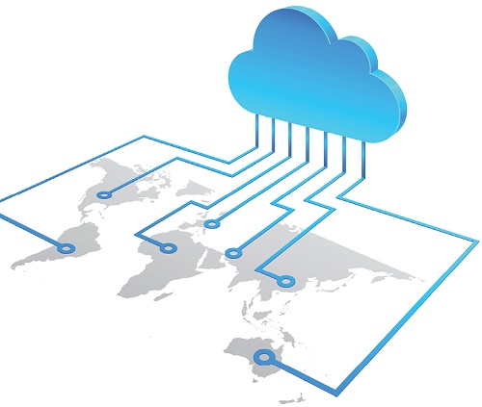
Distributed Compute
Cloud, national, and institutional compute resources

Slide 17
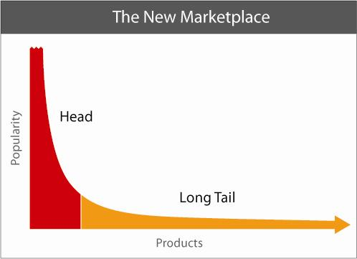
The Marketplace of Tools
Analyses to drive interoperability
Domain specific
analyses
Bioinformatics Applications

Slide 18

Leveraging Community Cyberinfrastructure

Slide 19

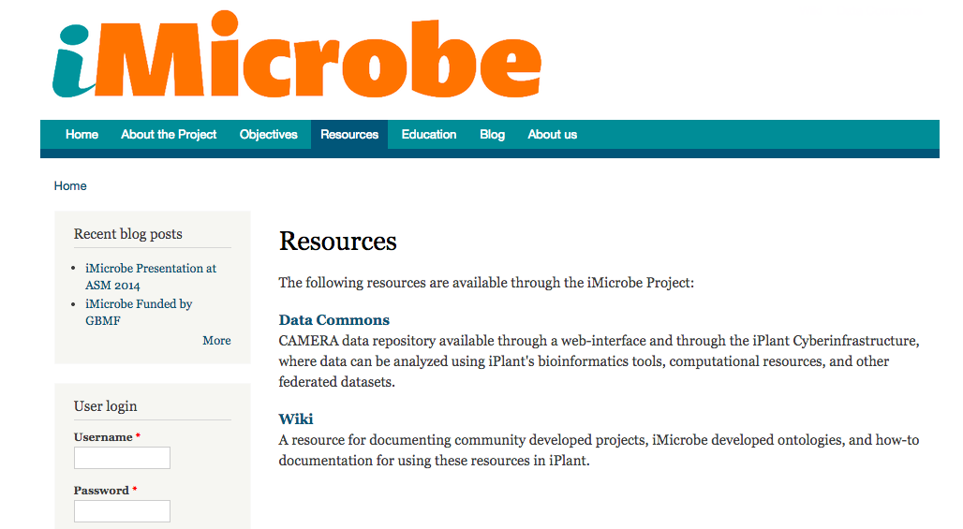
Light-weight Scalable Architecture
Server
Databases
(MySQL/Mongo)
Data Store
Stampede2
Backend
RESTful iMicrobe Server
(NodeJs/Javascript)
RESTful Agave API
HTTP/JSON
iMicrobe UI
(Elm/Javascript)
HTTP/JSON
Frontend
JS/HTML
Browser (Chrome, Firefox, etc)
User Interface
Notes:
Modularity (“Separation of concerns”)
Simplifies development
Easier to maintain
Easier to reuse/extend modules for other projects (MuScope, OCC)
Backend RESTful API can be used by third-parties
Elm (client-side rendering)
Statically-typed, purely functional language
More robust - No runtime errors!
vs. Perl, Javascript/React/Angular/Vue/…
More readable – Terse syntax and standard code structure
Very fast – virtual DOM
More efficient - fewer server requests
Single Page App (SPA) - WebPack

Slide 20
Integrated, modular bioinformatics tools (Apps) that run using CyVerse compute resources

Slide 21


Base Cluster (Dell/Intel/Mellanox):
Intel Sandy Bridge processors
Dell dual-socket nodes w/32GB RAM (2GB/core)
6,400 nodes
56 Gb/s Mellanox FDR InfiniBand interconnect
More than 100,000 cores, 2.2 PF peak performance
Co-Processors:
Intel Xeon Phi “MIC” Many Integrated Core processors
Special release of “Knight’s Corner” (61 cores)
All MIC cards are on site at TACC
more than 6000 installed
final installation ongoing for formal summer acceptance
7+ PF peak performance
Max Total Concurrency:
exceeds 500,000 cores
1.8M threads
What’s under the hood?
Stampede2
Base Cluster:
5,936 nodes
196 GB RAM / node
Max Concurrency:
>400,000 cores
18+ PF peak
30M award

Slide 22
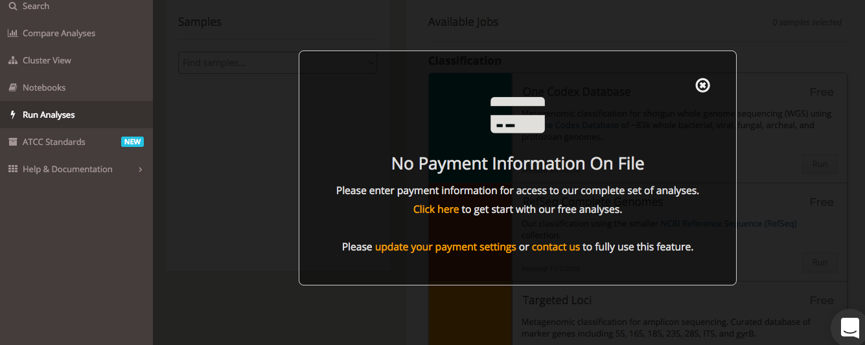
No Credit Card Required

Slide 23

A Registry of Biocontainers
6K+ containers
Community-driven
Serving the “long-tail”
Notes:
A container not bound to higher level constructs such as a particular client or orchestration stack, and
A container not tightly associated with any particular commercial vendor or project, and
A container portable across a wide variety of operating systems, hardware, CPU architectures, public clouds, etc
Composable. All tools for downloading, installing, and running containers should be well integrated, but independent and composable. Container formats and runtime should not be bound to clients, to higher level frameworks, etc.
Portable: The runtime standard should be usable across different hardware, operating systems, and cloud environments.
Secure. Isolation should be pluggable, and the cryptographic primitives for strong trust, image auditing and application identity should be solid.
Decentralized. Discovery of container images should be simple and facilitate a federated namespace and distributed retrieval.
Open. The format and runtime should be well-specified and developed by a community. We want independent implementations of tools to be able to run the same container consistently.
Code leads spec, rather than vice-versa. We seek rough consensus and running code.
Minimalist: The spec should aim to do a few things well, be minimal and stable, and enable innovation and experimentation above and around it.
Backward compatible: Given the broad adoption of the current Docker container format (8B+ container downloads to date), the new standard should strive be as backward compatible as possible with that format.

Slide 24
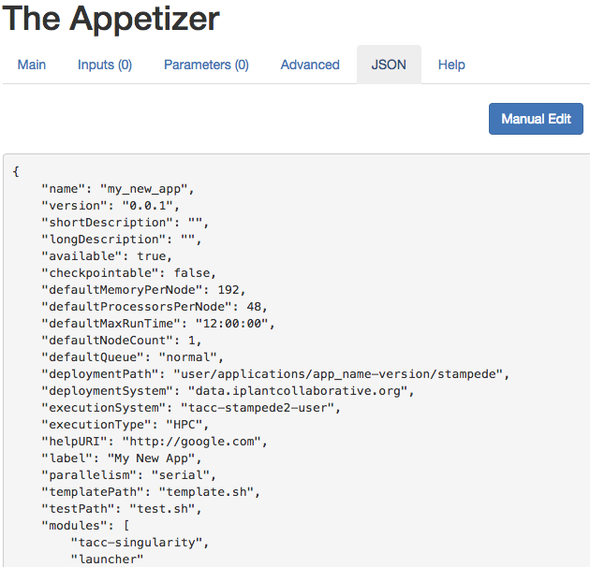
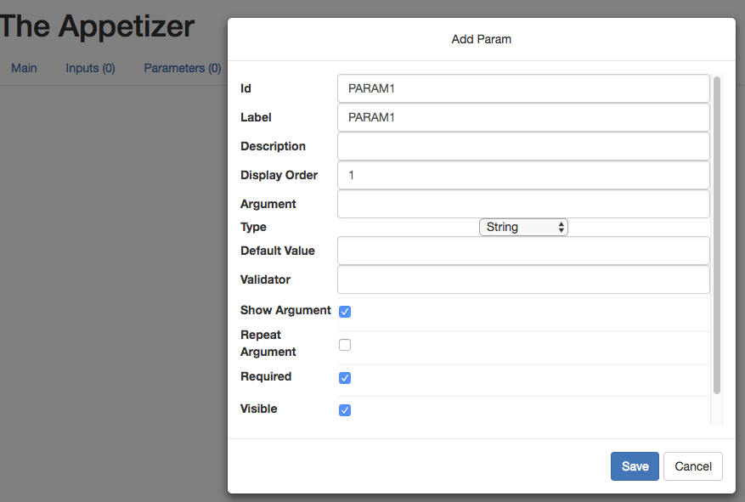
The Appetizer
Add or Update Parameters

Slide 25
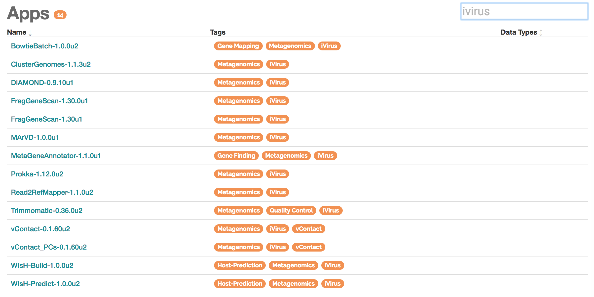

iVirus: Community-driven Apps
Apps from the Sullivan & Rich labs at Ohio State University

Slide 26

Known Viruses
5%
Known
Bacteria
57%
Unknown
43%
Unknown
95%
Microbiome
Virome

Slide 27
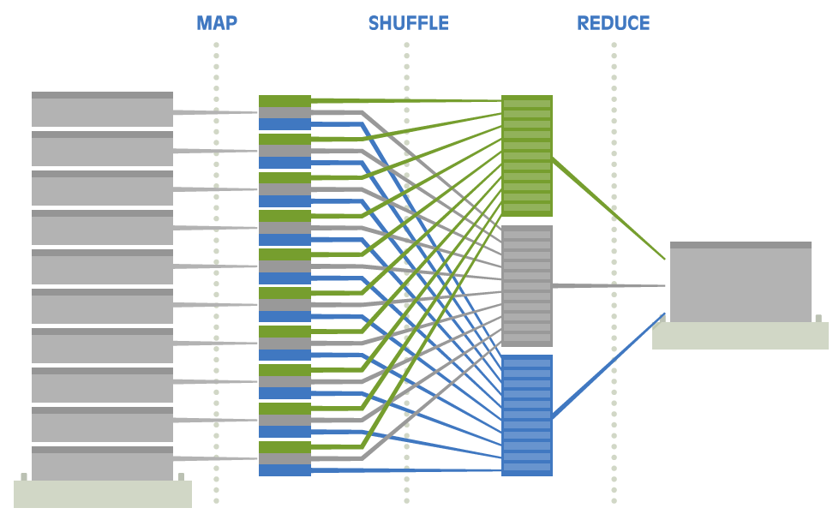
Access to Big Data Architectures
Group data on
a server by key
Send similar keys to the same server
Count the number
of instance for each key
Split Big Data
Green=13
Grey=15
Blue=12
Google Invented MapReduce in 2004 to Process Gargantuan Datasets
Notes:
Map (partitions out the jobs)
Reduce (collates the results

Slide 28
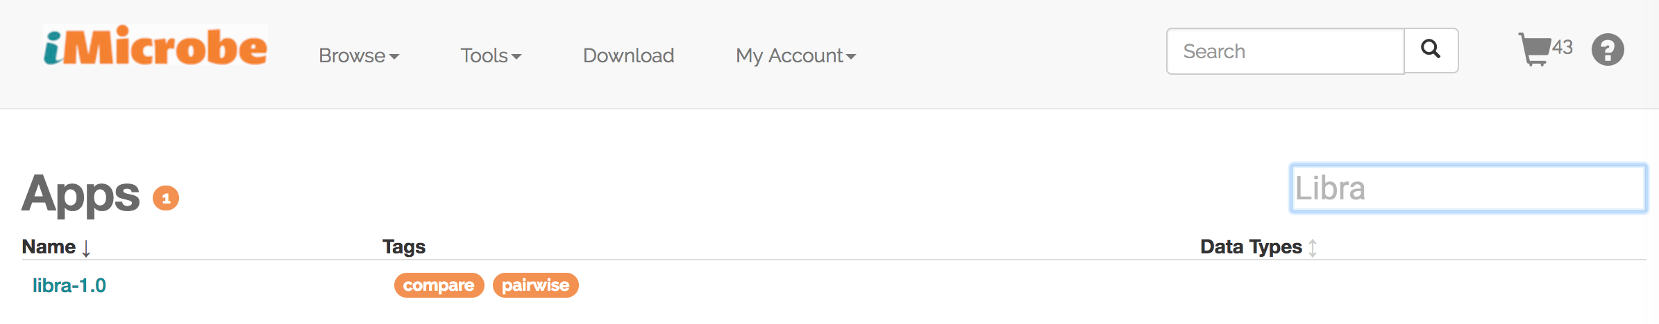
Simple Platform to Big Data Analytics
Choi, I., Ponsero, A., Hartman, J., Hurwitz B.L., 2017. Libra: Comparative metagenomics using MapReduce. In Review.

Slide 29
Enhanced Resolution of Microbial Communities
Mash (Sketching)
Libra (100% of reads)
16S
rRNA
WGS
Choi, I., Ponsero, A., Youens-Clark, K., Bomhoff, M., Watts, G., Hartman, J.H., Hurwitz, B. (2018) Libra: Comparative Metagenomics Using MapReduce. In review.

Slide 30
Public Microbiome Data
User Data & Compute
Web-accessible data repositories
Agave API
Integrating community-driven data, tools, compute
Appetizer

Slide 31


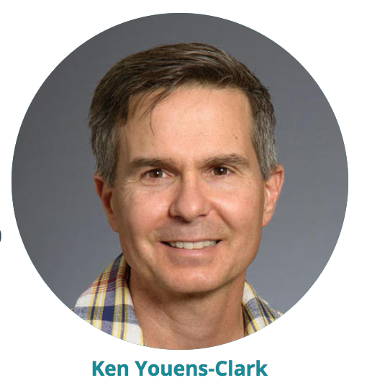
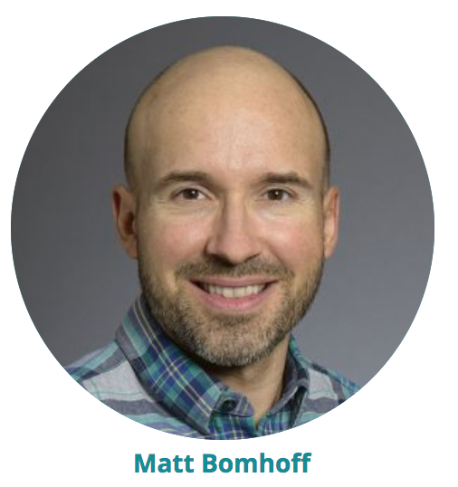
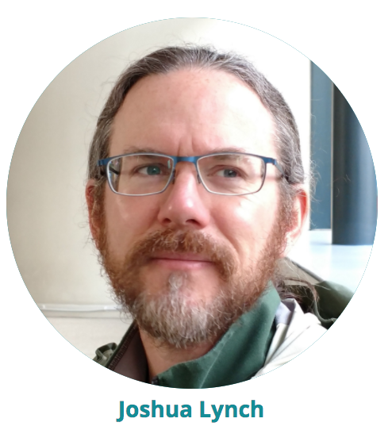
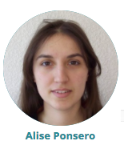

Slide 32
Simulated Mock Communities for Benchmarking

Slide 33
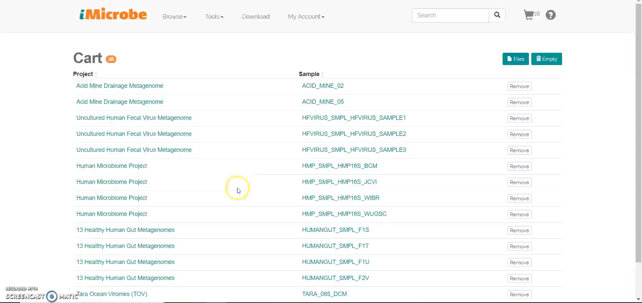
Shop for Data and Run Analyses
Notes:
How do I run an app on data in my card (MASH)

